Slide 1

MapKvetch
Damn, where is the Seminary?
A Map-Based iPhone App of Jewish Landmarks in NYC

Slide 2
Overview //ReadMe
What is MapKvetch?
Modern Jewish Studies
Computer Science
Language
Project Design
Why An App?
How is this done?
Future Plans
Demo

Slide 3
Start Kvetching //init
MapKvetch is a Map-Based iPhone app which allows users to find Jewish landmarks around New York City.
Location-based
App would focus on the user’s location
No Loading
All data is stored in-app, can be accessed even if user does not have an internet connection.
Also allow for the ability to download info if desired.

Slide 4
Modern Jewish Studies //lib
Modern Jewish Literature
The Immigrant Experience
Abraham Cahan (Yekl, Imported Bridegroom)
Anzia Yezierska (Bread Givers)
Holocaust
Art Spiegelman (Maus)
Modern Conservative Experience
Greenburg Hebrew Center (My Synagogue)
JTS

Slide 5
Computer Science //lib
Application Development
User Experience Design
Mobile Development
Building great user experiences

Slide 6



+ =
?

Slide 7
Language //Objective-C
JTS and CU experiences parallel on Language
JTS: Study English, Hebrew, Yiddish
CU: C, C#, Java, Python, Lisp, …
We use language every day, take it for granted
Language goes into making great literary works as well as making great apps

Slide 8
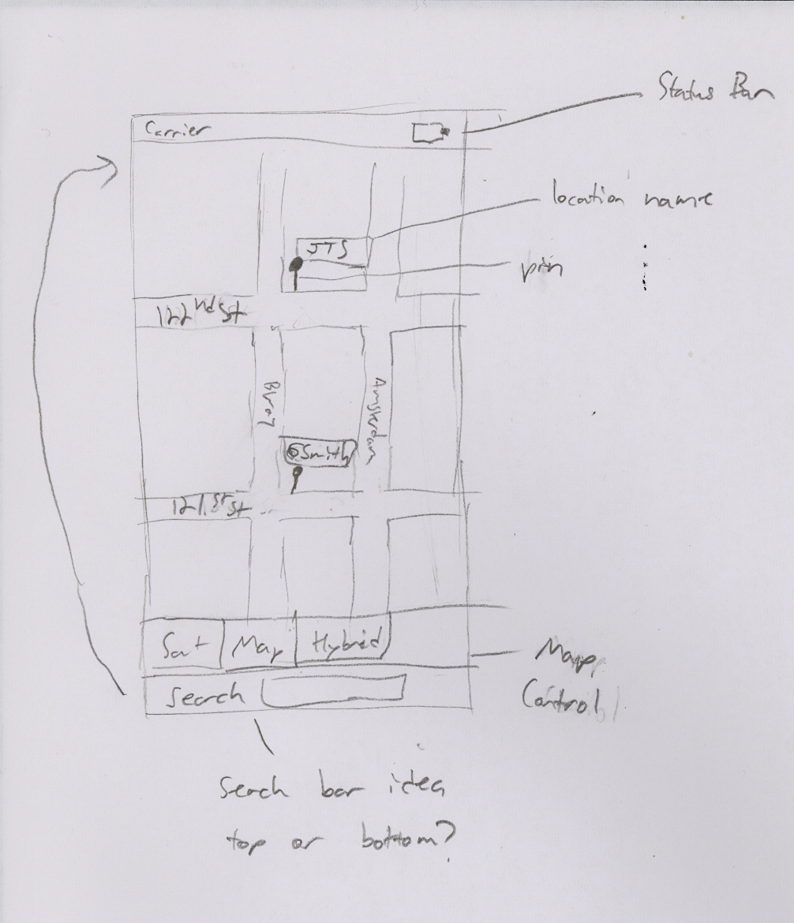
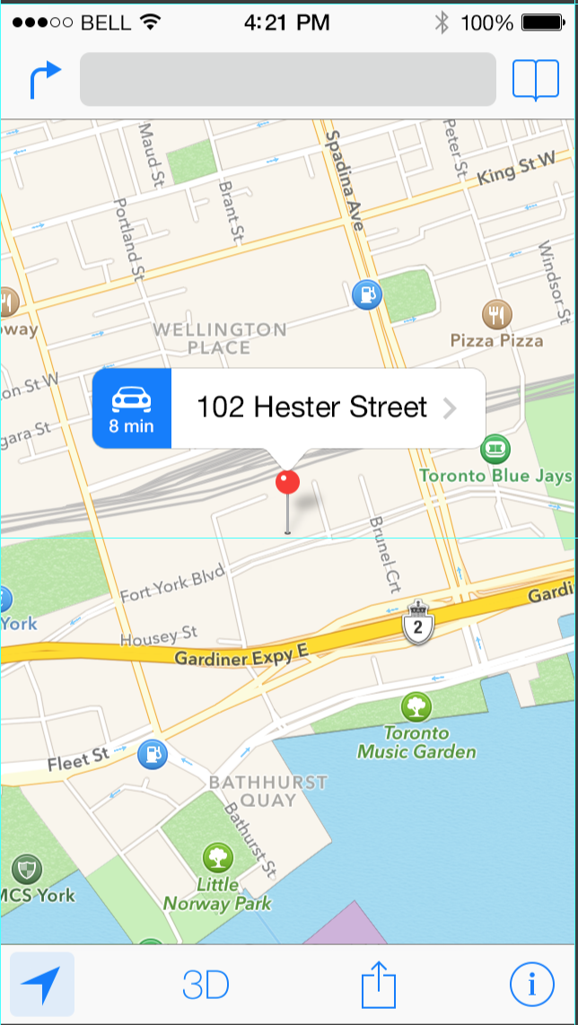
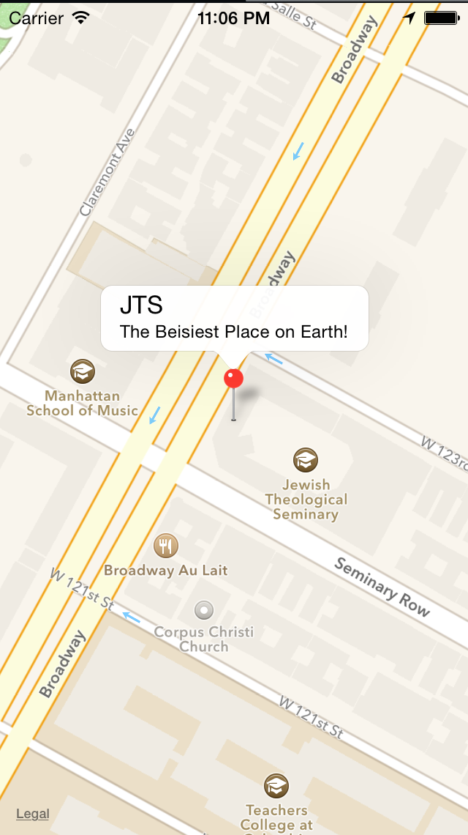
Design //GUI

Slide 9
Why An App? //Cocoa Touch
Mobile, anyone can access it anywhere
Gives me an excuse to design for a new platform/language
Open-Source software
Release this framework to the Jewish community
Allows me to connect my MJS and CS majors

Slide 10
How is this Done? //make
Xcode - Apple’s iOS Integrated Development Environment (IDE)
MapKit Framework - Apple Maps framework for creating map-based apps
Git - version control software
Github - Free hosting for open-source projects

Slide 11
Future Plans //TODO
Custom Pin Icons
Location Detail View
Location Search

Slide 12
Demo ./execute

